Slide 1
Autism Sprectrum Disorder

Slide 2
GROUP MEMBERS
-
Antra Amrit
21052480
-
Saurabh Sushant
21051335
-
Roshan Sisodia
21052611
Brijit Adak
-
ADD YOUR TEXT
ADD YOUR TEXT
Aastha Anand
21052126
-
Brijit Adak
21052410

Slide 3
01
Introduction
05
Machine learning
used in ASD
02
Description
CONTENTS
06
Model used
03
Treatment
therapies
07
Comparison of
result
04
Technology used
in Autism detection

Slide 4
08
Dataset used
in experiment
12
Conclusion
09
Questions in
dataset
CONTENTS
13
References
Chart of accurancy,
precision,recall and
f1-score
10
11
Diagram

Slide 5
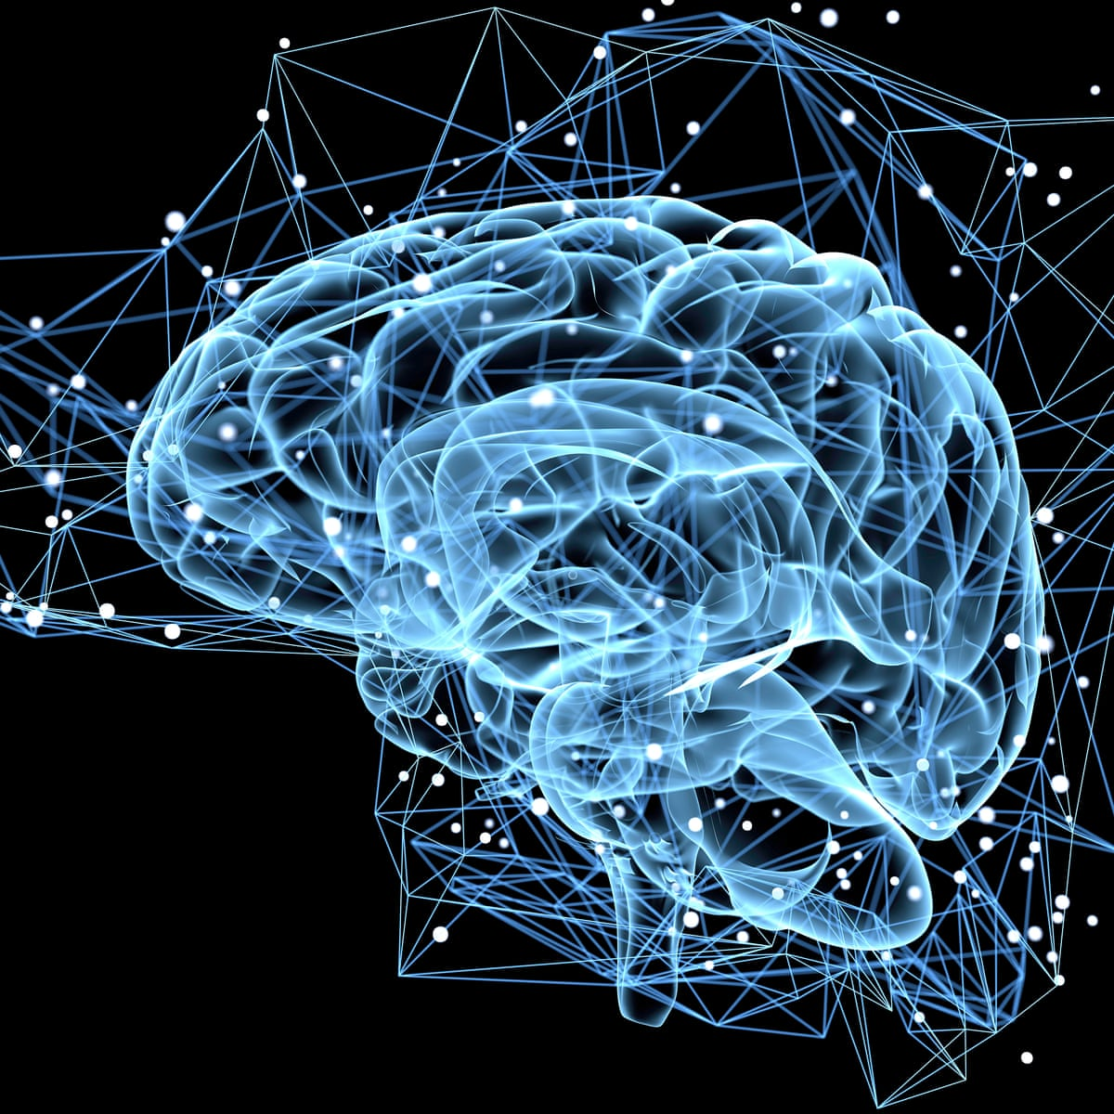
INTRODUCTION
This presentation provides a comprehensive overview of Autism Spectrum Disorder (ASD), covering its characteristic, diagnosis, and treatment options . Gain a deeper understanding of this complex neurodevelopmental condition.

Slide 6

What is ASD?
Autism, described first by Kanner in 1943, is a developmental disorder commencing in early childhood.
complex neurodevelopmental condition.
Boys are 4 times more likely than girls to be affected.
challenges with social communication and repetitive behaviors.
spectrum disorder, meaning its impact varies widely from person to person.

Slide 7
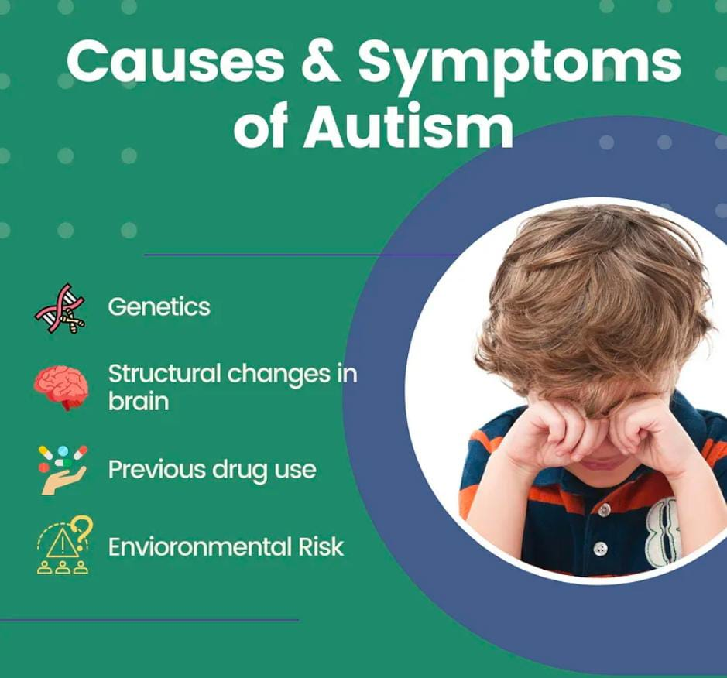
WHAT IS THE CAUSE OF AUTISM?
The cause of autism is unknown and no one particular anatomical, biochemical or genetic disorder has been found in those who suffer from it. The problem appears to lie in that part of the brain responsible for the development of language.

Slide 8
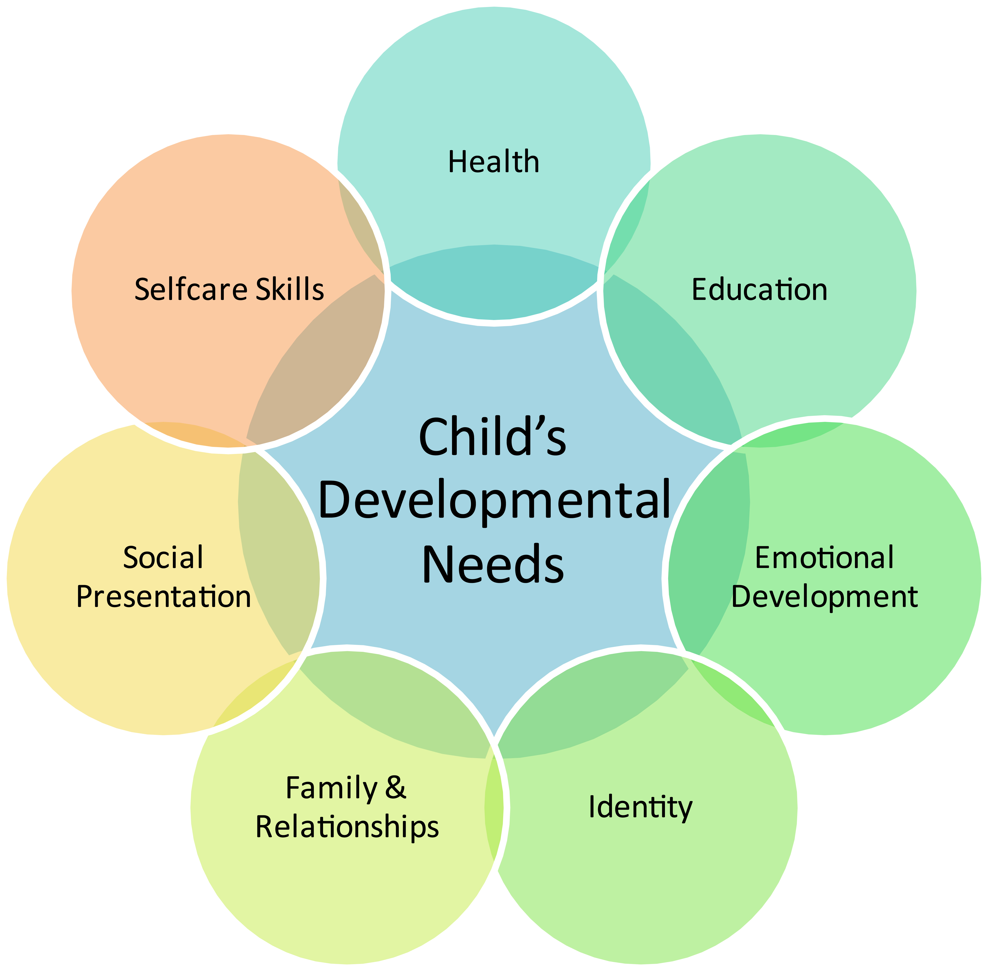
Diagrams

Slide 9
Signs of Autism
Inappropriate playing with toys
Inability to relate to others
Hyperactivity or passiveness
Inappropriate laughing or crying
Oversensitive or undersensitive to sounds
Strange attachment to objects
Poor Speach or lack of speach
Difficulty dealing with challenges to routine
Lack of awareness to danger

Slide 10
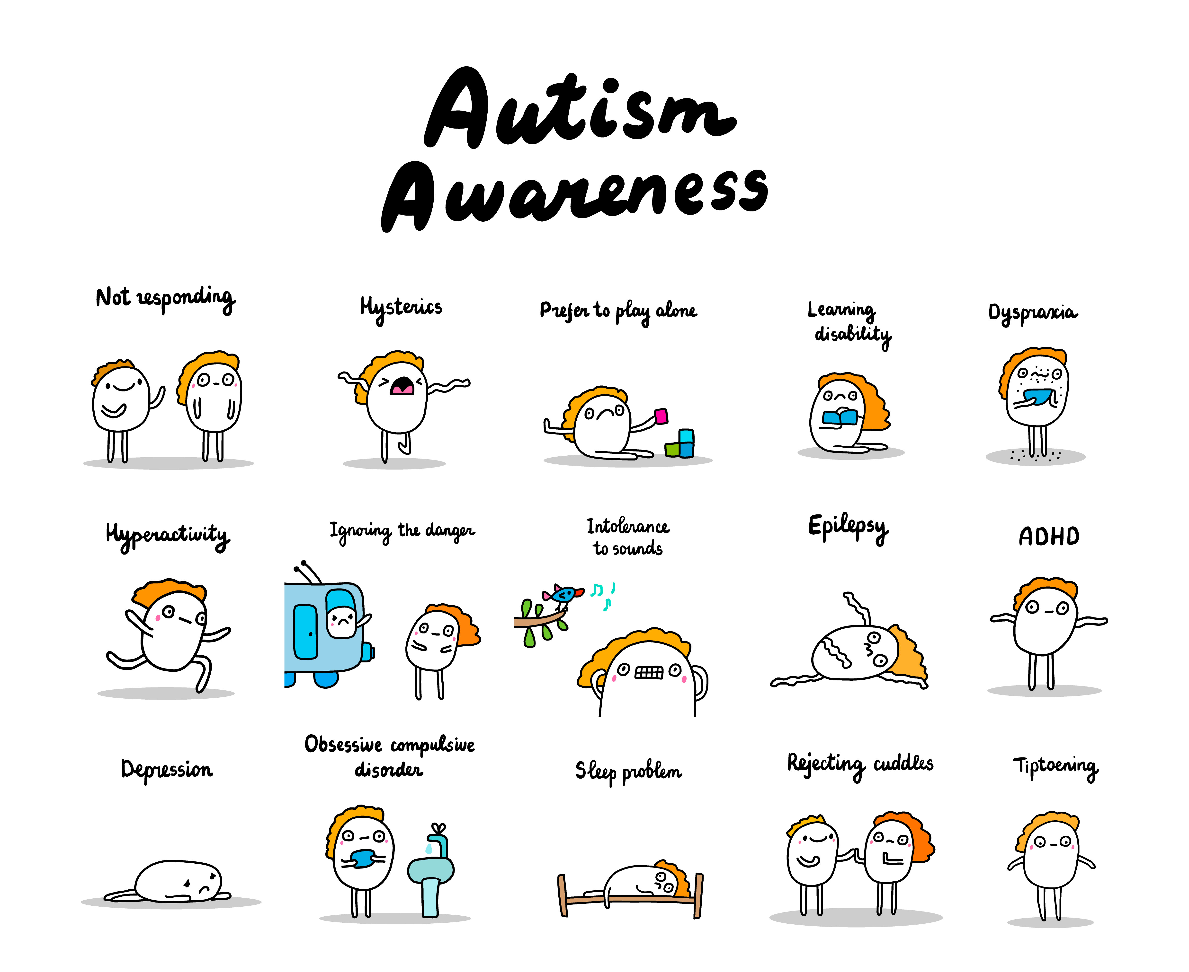
Signs of Autism
Not responding
Hysterics
Prefer to Play alone
Learning Disability
Dyspraxia
ADHD (attention deficit hyperactivity disorder)
Depression
Obsessive complusive disorder
Sleep problem
Rejecting cuddles
Tiptoering

Slide 11
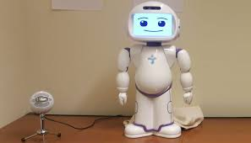

Treatment therapies for autism
Therapy sessions are meetings with patients with a goal to improve some aspects of their life.Initiating it early may help to improve skills and resolve their symptoms. Some of them are mentioned below:
Socially Assistive Robotics (SAR):
It refers to the robotics that focuses on developing robots designed to interact
with humans in emotionally intelligent manner.
They teach and demonstrate socially beneficial behaviors. This tool assists children in expressing themselves in a better way.
Nutrition therapy:
It is typically conducted by registered dietitians.Getting enough vitamins, minerals, and healthy fats from food is really important. A good diet can help manage some of the symptoms of autism and keep them under control.

Slide 12
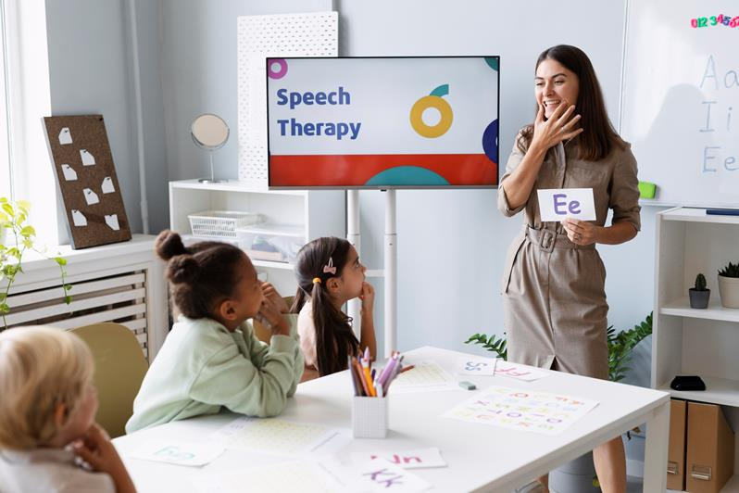
Treatment therapies for autism
Speech Therapy:
It is helpful in resolving communication and speech issues.
Children can make use of sign language or images to communicate.
It enhances the clarity in sound production.
Occupational Therapy:
The primary goal of occupational therapy is to enable individuals
to participate in activities that are meaningful to them.It helps them get better at everyday tasks. In therapy, they focus on what each person needs and what they want to achieve.

Slide 13
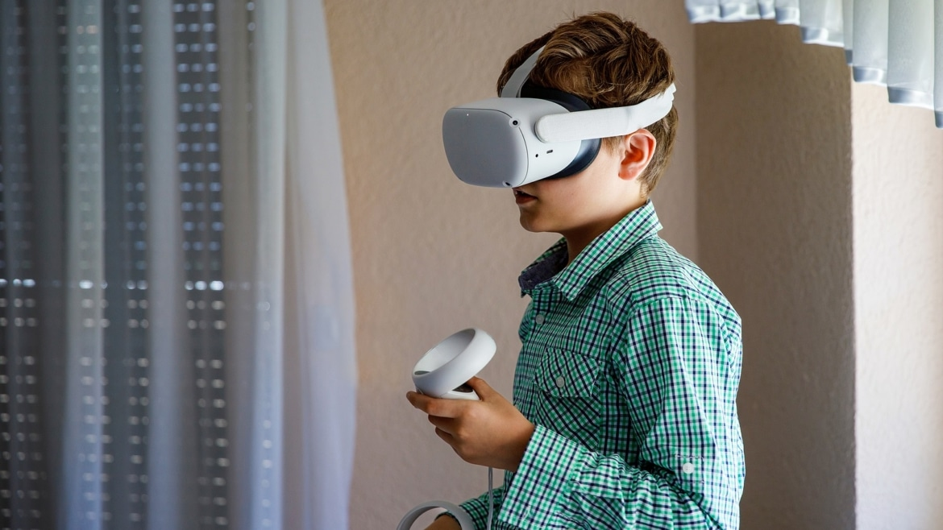
Technology used in Autism detection
Technology is helpful for people with autism. It helps them learn and communicate better. For example,
if they have very little focus duration,they can use pictures and sounds to keep them focused.
Some of them are as follows:
Gaming:
That is Learning vocabulary using games
Virtual Reality:
Real world is presented to autistic children with help of Virtual Reality.
Augmented Reality:
Facial expressions can be used to detect the symptoms.
Social Robots:
Social robot are used by therapists for communication,thus Helping
children with less involvement.

Slide 14
Machine Learning Algorithms used in detection survey.(ABIDE dataset is used)
METHODS | ALGORITHMS | ACCURACY | Limitations/ Future scope
Functional magnetic resonance imaging (fMRI) | Linear Discriminant Analysis (LDA) KNN, SVM, LR | 77.7% 73.7% 75.5% 76.6% | Indirect measurement of neural activity.
Resting-state functional magnetic resonance imaging(rs-fMRI) | SVM Logistic regression, ridge | 71.40% 71.79% 71.98%. | Integration of ML classifiers with other clinical features for accurate results
Resting-state functional magnetic resonance imaging(rs-fMRI) | SVM | Male71.6% Female 93.7% as ASD

Slide 15
ML Algorithms Details
Following Machine Learning Algorithms were tried:
Random Forest: Classification
Though Decision trees works very well for classification, Random forest is used to take care of overfitting.
Random forest is much more powerful than Decision trees when trees are diverse.
Decision Trees : Classification
It’s a non-parametric supervised learning algorithm for Classification and regression.
It has a problem of overfitting.
Naïve Bayes : Supervised Classification
It is based on Bayes Theorem, and it’s used for solved classification problems.
It’s mainly used for text classification.

Slide 16
ML Algorithms Details – Conti-
Following Machine Learning Algorithms were tried:
Logistic Regression: Binary Classification
It is used to predict the categorial dependent variable.
It answers mostly in the format yes or no.
Support Vector Machine: Supervised Classification
It creates best line or decision boundary that can best segregate n dimensions spaces into classes to accommodate new data points.
Artificial Neural Network :
Deep Learning algo
It uses Neural network.

Slide 17
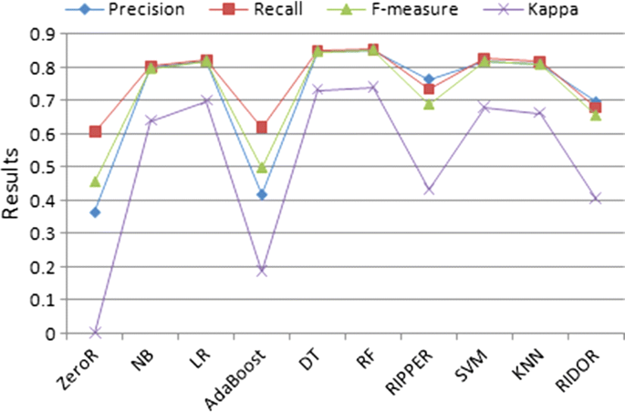
Final Selected Model/s
Ranking of the models based on the results of below parameters:
Recall
1. Random Forest
2. Decision Tree
3. Logistics regression
4. SVM
5. KNN
6. NB
7. Ripper
8. Ridor
9. AdaBoost
10. ZeroR
It can be concluded that better performance is given by Decision tree and Random Forest.

Slide 18
System Architecture
Data Reprocessing
(Normalization & Eliminating missing values)
Loading of Preprocessed Data
Applying Classification Algorithm
Evaluation of ASD and no ASD classes
Autism Raw Dataset

Slide 19
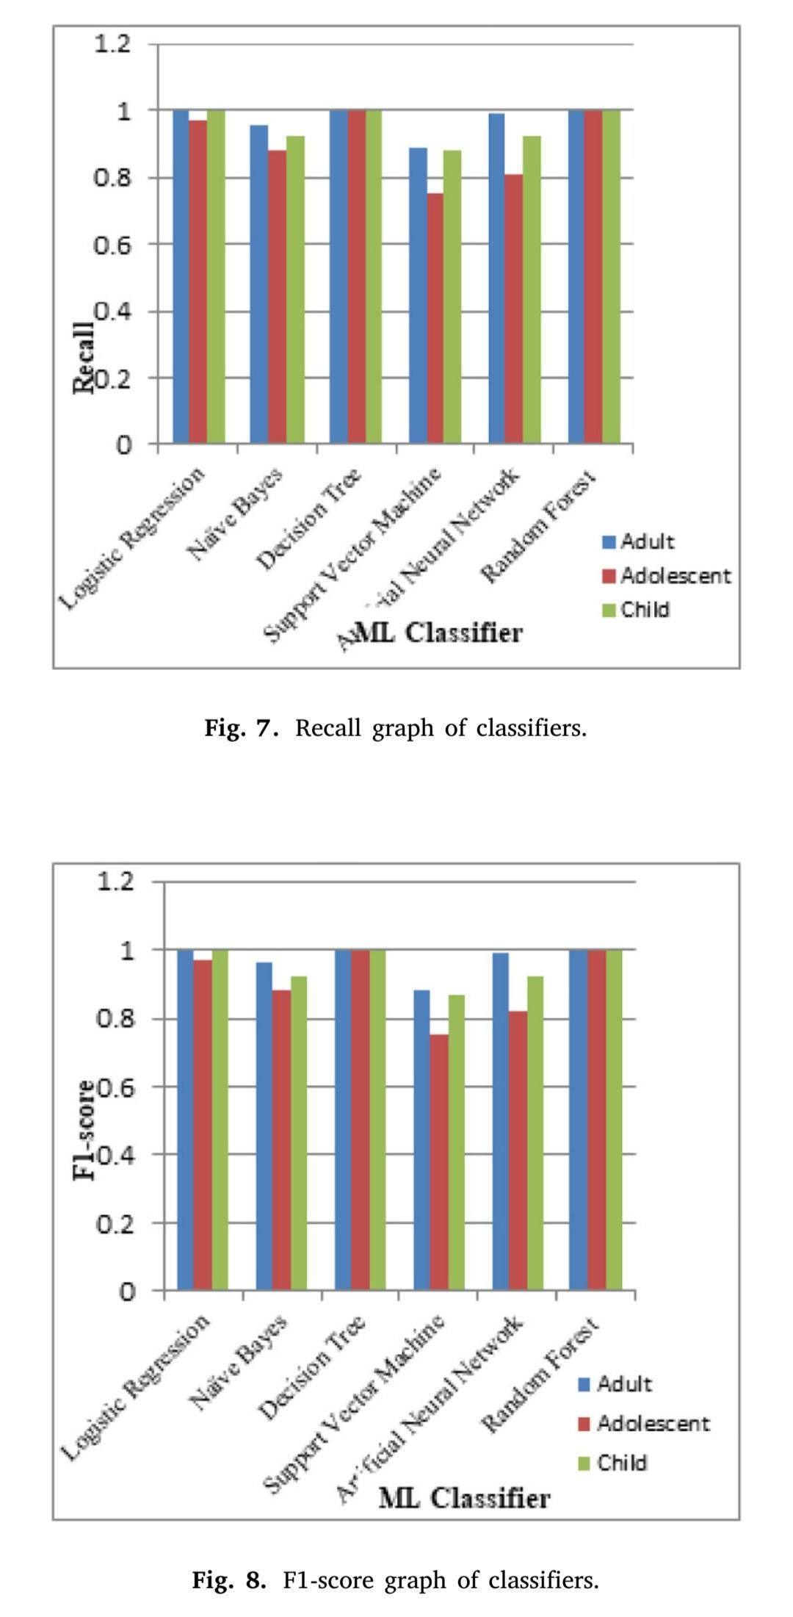
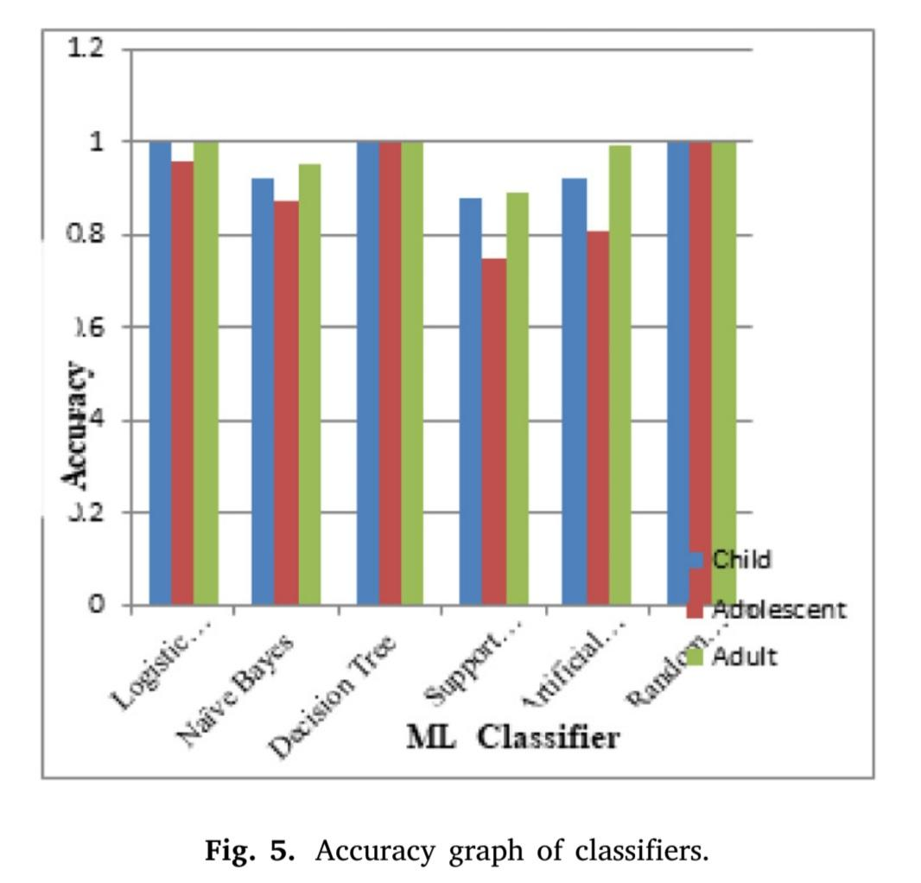
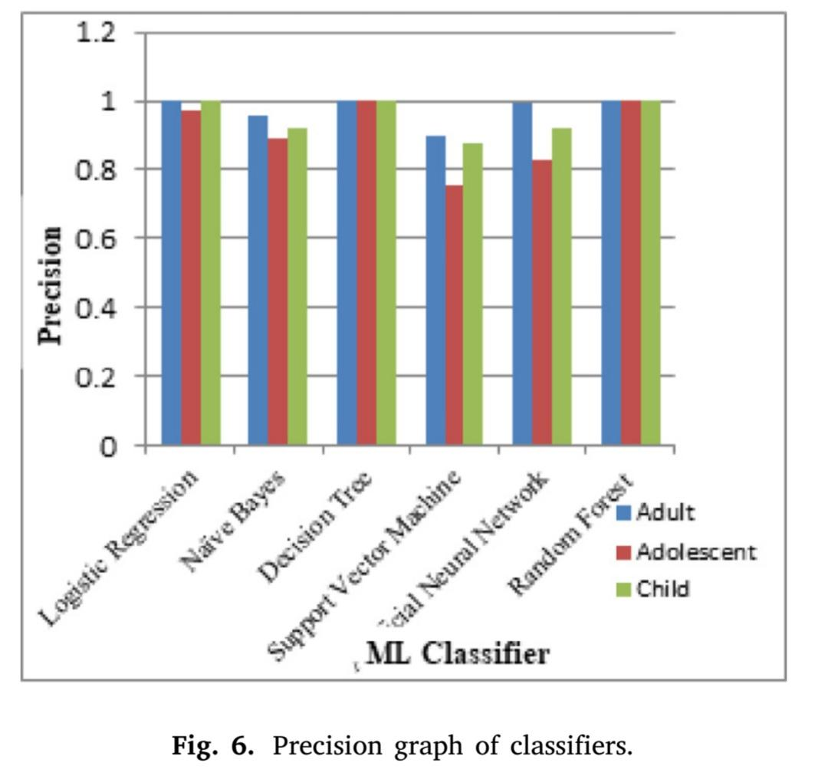
Result Comparison with Different Algos
Below are the charts of all the algorithms based on different parameters:

Slide 20
Datasets used in the Experiment
UCI Machine Learning Repository made available by Fadi Fayez Thabtah.
ASD screening child dataset -> 292 (141 ASD:151 non-ASD) records.
Adolescent Dataset -> 104 (63 ASD:41 non-ASD) records.
Adult Dataset -> 704(189 ASD:515 non-ASD) records.
There are 21 properties in which 10 questions (AQ1-AQ10) are about behavioural information and 10 demographic attributes with one class label as either yes or no.
Here we used A1_Score to A10_Score, age, gender, ethnicity, jaundice, austim, contry_of_res, used_app_before, result, age_desc, Class/ASD for training our model.

Slide 21
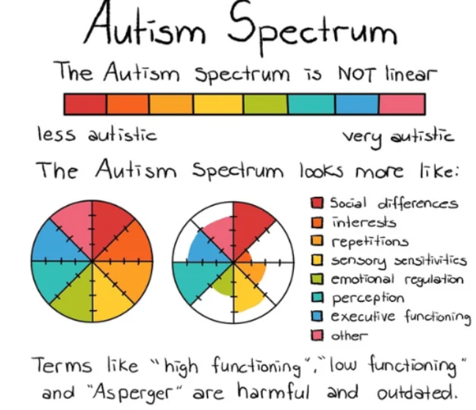
Questions in Dataset
Able to hear sound that others can't hear.
Targets on large picture than small details.
Pursue the discussions of people in a
community group.
Can effectively switch between available actions.
No idea about how to chitchat with peers.
Fine for day-today small chats.
Finding hard to understand emotions while
reading a book.
Fond of playing role plays as part of
(pre-school) education.
Recognize their experience by observing
facial expressions
Hard to create new friends
Background('White-European', 'South Asian',

Slide 22
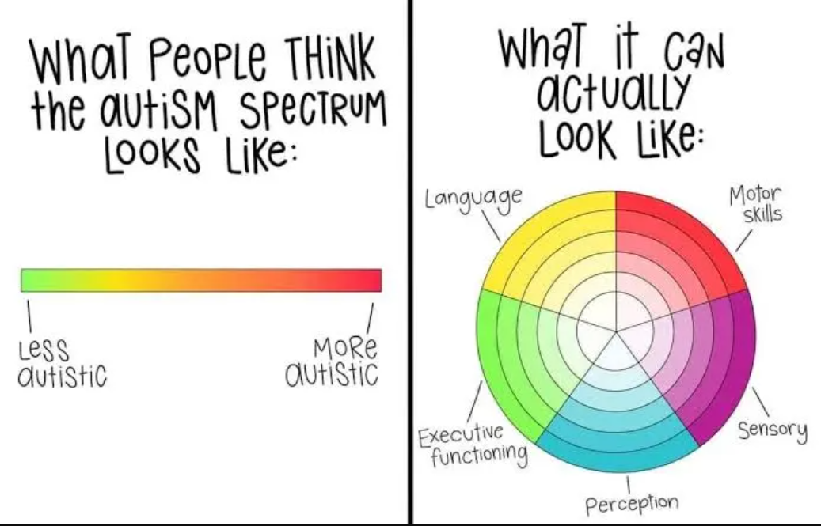
Questions in Dataset
'Asian', 'Middle Eastern ', 'Pasifika',
'Hispanic', 'Turkish','Latino', 'Black',
'Others', 'Unknown')
Born with jaundice (yes, no)
Family member with PDD (yes, no)
Country
Familiar with the screening app (yes, no)
Score
Age_desc
Who has attempted the test
Class/ASD

Slide 23
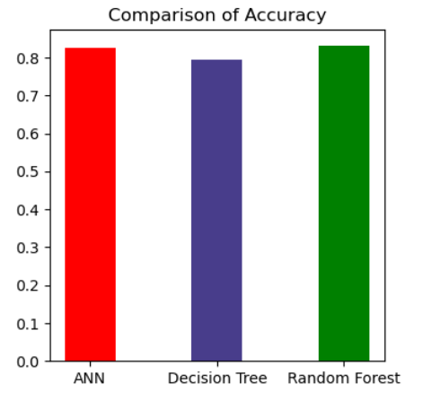
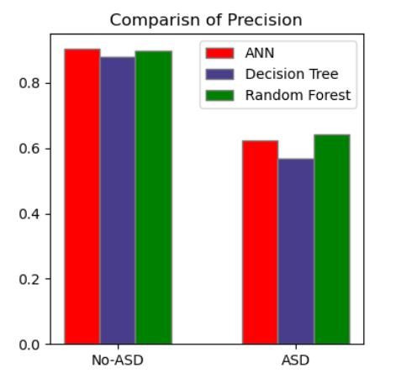
Model Evaluation Chart
1. Accuracy=(TP+TN)/(TP+TN+FP+FN)
2. Precision= TP/(TP+FP)

Slide 24
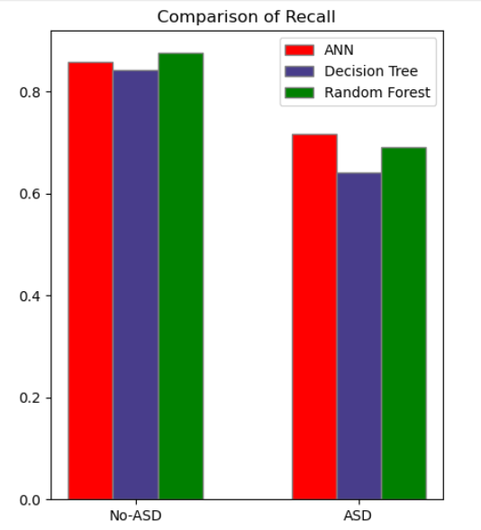
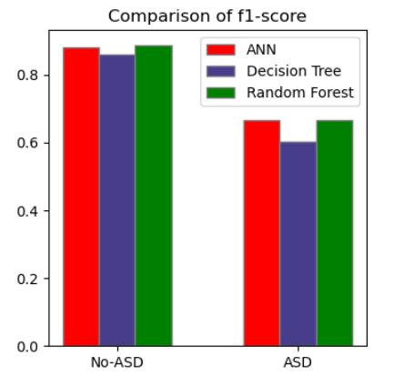
Model Evaluation Chart
3. Recall = TP/(TP+FN)
4. F1-Score =2(Recall*Precision)/(Recall+Precision)

Slide 25

Future Plans
At future our goal is to collect more no of patient data through any authenticated source.
Implement other models to get the best possible outcome.
Reevaluate our input attributes and updating them if after that better result comes

Slide 26
Conclusion
In conclusion, autism spectrum disorder (ASD) is a complex neurodevelopmental condition that affects individuals in diverse ways. Through this presentation, we've explored the key characteristics, diagnostic criteria, prevalence, and potential causes of autism. It's crucial to recognize that each person with autism is unique, with their own strengths and challenges.
While there is still much to learn about autism, increased awareness, acceptance, and support are essential for improving the lives of individuals on the spectrum. Early intervention and personalized therapies can significantly enhance outcomes and help individuals with autism reach their full potential.
As we continue to advance our understanding of autism, let us strive for a society that embraces neurodiversity, promotes inclusivity, and provides equal opportunities for individuals of all abilities. Together, we can create a more compassionate and supportive world for everyone, including those with autism.

Slide 27
References
American Psychiatric Association. (2013). Diagnostic and Statistical Manual of Mental Disorders (5th ed.). Arlington, VA: American Psychiatric Publishing.
Baio, J., Wiggins, L., Christensen, D. L., et al. (2018). Prevalence of Autism Spectrum Disorder Among Children Aged 8 Years — Autism and Developmental Disabilities Monitoring Network, 11 Sites, United States, 2014. MMWR. Surveillance Summaries, 67(6), 1–23.
Happé, F., & Ronald, A. (2008). The ‘fractionable autism triad’: a review of evidence from behavioural, genetic, cognitive and neural research. Neuropsychology Review, 18(4), 287–304.
Lai, M. C., Lombardo, M. V., & Baron-Cohen, S. (2014). Autism. The Lancet, 383(9920), 896–910.
National Institute of Mental Health. (2019). Autism Spectrum Disorder. Retrieved from https://www.nimh.nih.gov/health/topics/autism-spectrum-disorders-asd/index.shtml
Volkmar, F. R., & McPartland, J. C. (2014). From Kanner to DSM-5: Autism as an Evolving Diagnostic Concept. Annual Review of Clinical Psychology, 10, 193–212.
World Health Organization. (2018). Autism Spectrum Disorders. Retrieved from https://www.who.int/news-room/fact-sheets/detail/autism-spectrum-disorders

Slide 28
THANK YOU

